Slide 1


The Power of
Organ, Tissue and Eye Donation Education
Wisconsin Driver’s Education
https://donatelifewisconsin.org/

Slide 2

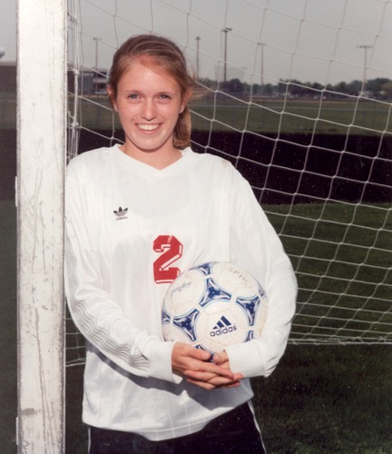
Kelly’s Story
Kelly was 16 when she died following a car accident. It happened just a month after she received her driver’s license.
“When I took Kelly to the DMV to try for her license, the question of organ donation came up,” her mother, Mary, said. “It wasn’t something I expected. I asked, ‘What do you think Kel?’ and she said, ‘Well of course, Mom, why wouldn’t I?’ As a parent, it was one of my proudest moments.”
“We did not have to make the decision to donate her organs - she had made it for us. I’ve always felt that was such a gift to us, in addition to those whose lives she saved.
Kelly saved the lives of three strangers. Her story also inspired lawmakers to pass WI State Statute #343.71, requiring Wisconsin driver education courses to include a minimum of 30 minutes of instruction about organ, tissue and eye donation. That bill, the “Kelly Nachreiner Bill,” is why you are viewing this slide show.

Slide 3
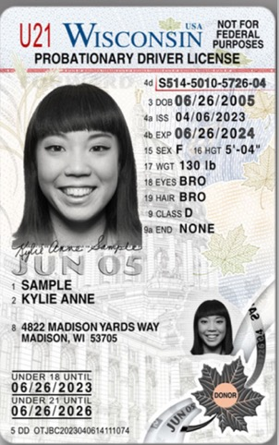
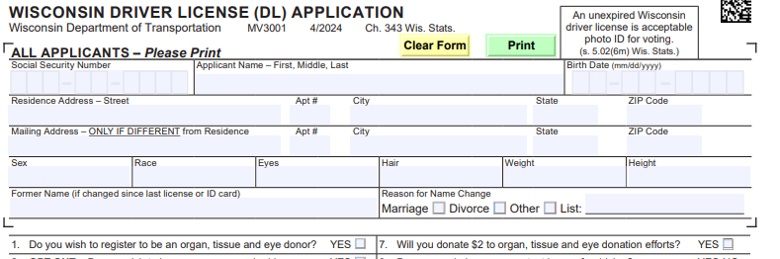
When Applying for Your License
When you apply for your driver’s license, you’ll be asked to make a big, potentially lifesaving, decision. You’ll be asked whether you wish to register as an organ, tissue and eye donor - a decision that could save someone’s life.

Slide 4
What do you already know
about organ, tissue and eye donation?
Let’s see…

Slide 5
QUESTION #1
25,000+
How many people are on the national waiting list for a life-changing transplant?
B. 100,000+
C. 500,000+

Slide 6
ANSWER #1
A. 25,000+
B. Over 100,000 are waiting in the U.S.
More than 1,400 Wisconsin residents are on that list.
B. 100,000+
C. 500,000+
Notes:
Resource: https://donatelife.net/donation/statistics/

Slide 7

QUESTION #2
A. 0-5
How many people die each day waiting for a life-saving transplant?
B. 6-14
C. 15-20+

Slide 8
ANSWER #2
A. 1-5
C. 15-20+
people die each day while on the waitlist.
B. 6-14
C. 15-20+
Notes:
Resource: https://donatelife.net/donation/statistics/

Slide 9
QUESTION #3
A. 2
How many lives can one organ donor save?
B. 4
C. 8
D. 12

Slide 10
ANSWER #3
A. 2
C. 8
One organ donor can save the lives of up to 8 people.
B. 4
C. 8
D. 12
Notes:
Resource: https://www.organdonor.gov/learn/organ-donation-statistics

Slide 11

QUESTION #4
A. Skin
What organs and/or tissues can I donate? Choose all that apply.
B. Cornea
C. Kidney
D. Liver

Slide 12
ANSWER #4
A. Skin
A, B, C, and D
We have 8 organs: heart, liver, 2 lungs, 2 kidneys, pancreas and small intestine.
One person can heal the lives of up to 75 people through tissue donation.
B. Cornea
C. Kidney
D. Liver
Notes:
Resource: https://unos.org/transplant/facts/#:~:text=Fact:%20People%20of%20all%20ages,so%20they%20know%20your%20wishes.

Slide 13
QUESTION #5
What can I donate as a LIVING donor? Choose all that apply.
A. Kidney
B. Partial liver
C. Blood & bone marrow

Slide 14
ANSWER #5
A. Kidney
Living donors can give:
A, B, and C
B. Partial liver
C. Blood & Bone marrow
Notes:
Resource: https://donatelifewisconsin.org/living-donation/

Slide 15
QUESTION #6
I am LGBTIQA. Can I still donate organs, tissue and eyes?
A. No
B. Yes

Slide 16
ANSWER #6
A. No
B. Yes
Gender, race, and sexual identity are not considered for donation eligibility.
B. Yes
Notes:
Resource: https://donatelife.net/faqs/lgbtq/#:~:text=A%20person's%20sexual%20orientation%2C%20gender,and%20Human%20Services%20(HHS).

Slide 17

QUESTION #7
My grandparents are OLD! Can they be donors?
A. Yes
B. No

Slide 18
ANSWER #7
B. Yes
There is no age limit when it comes to donation. People living into their 90’s have been donors!
A. Yes
B. No
Notes:
Resource: https://www.organdonor.gov/learn/who-can-donate

Slide 19

QUESTION #8
A. When you apply for a Driver’s License or State I.D. at the DMV
How can I register to become an organ, tissue and eye donor?
Choose all that apply.
B. Online at: www.donatelifewisconsin.org
C. When you apply for a hunting, fishing or trapping license through the DNR

Slide 20
ANSWER #8
A. When you apply for a Driver’s License or State I.D. at the DMV
A, B, and C
No matter your choice, you should discuss your decision with your family.
B. On www.donatelifewisconsin.org
C. When you apply for a hunting, fishing or trapping license through the DNR
Notes:
Resource: https://donatelifewisconsin.org/orange-dot/
Resource: https://donatelifewisconsin.org/

Slide 21



How Did You Do?

Slide 22
Today you will learn about:
the need for donation
who is eligible to become an organ, tissue and eye donor
what organ and/or tissue a person can donate
how donation works
the importance of making a decision AND the importance of discussing this decision with loved ones
resources to learn more
how to make an informed decision regarding donation

Slide 23
Is there a Need for Donation?
Notes:
Answer appears after you click.

Slide 24

Did you know…
More than 2,100 children, under the age of 18, are on the waiting list.
27% of those are under the age of 5.
In 2023, more than 1,900 children received life-saving transplants, matched from nearly 900 pediatric organ donors.
Notes:
Resource: https://donatelife.net/donation/types/pediatric-donation/

Slide 25

Can I Donate?
The more people who register as an organ and tissue donor, the more people can be helped.
There is NO age limit for being a donor.
Lifestyle choices such as smoking/vaping, drug use, or alcohol use don’t rule you out for donation.
Conditions such as diabetes, HIV positive status, or cancer does not prevent you from being a donor.
Gender, race, sexual identity or a person’s wealth status is not included in the decision-making process.
Notes:
Resource: https://www.dhs.wisconsin.gov/donatelife/faq.htm

Slide 26
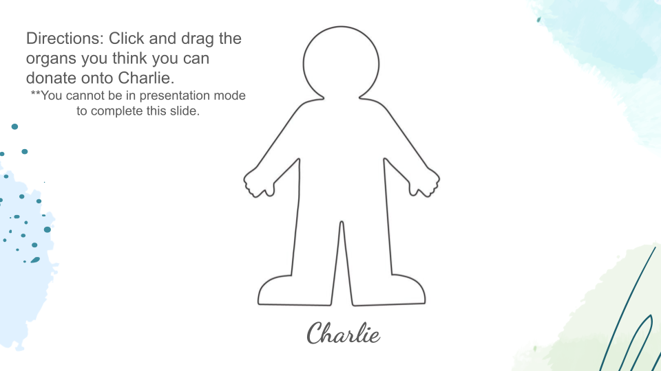
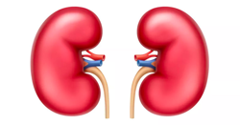
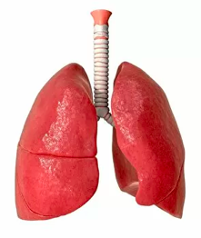
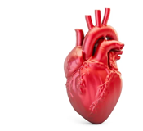
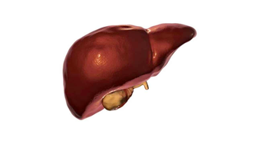
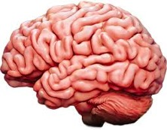
KIDNEYS
HEART
LUNGS
LIVER
BRAIN
Notes:
All can be donated for transplant except Gallbladder - you don’t need it to survive, and it can be removed if infected

Slide 27
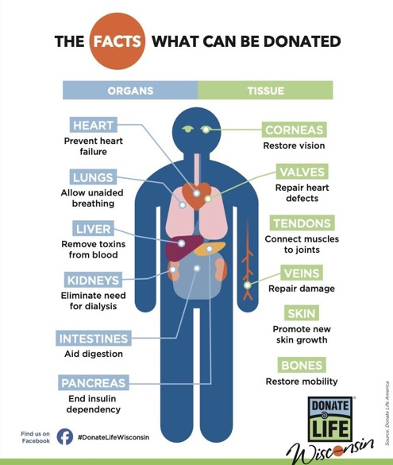
What Can I Donate?
If you chose liver, lungs, heart and kidneys, you are CORRECT! Here is a list of all the other organs and tissues you can donate.
ORGANS | TISSUES
Heart | Cornea
Lungs (2) | Heart Valves/Pericardium
Liver | Tendons/Ligaments
Kidneys (2) | Veins
Intestines | Skin
Pancreas | Bone Grafts
Notes:
Resource: Donate Life Wisconsin

Slide 28
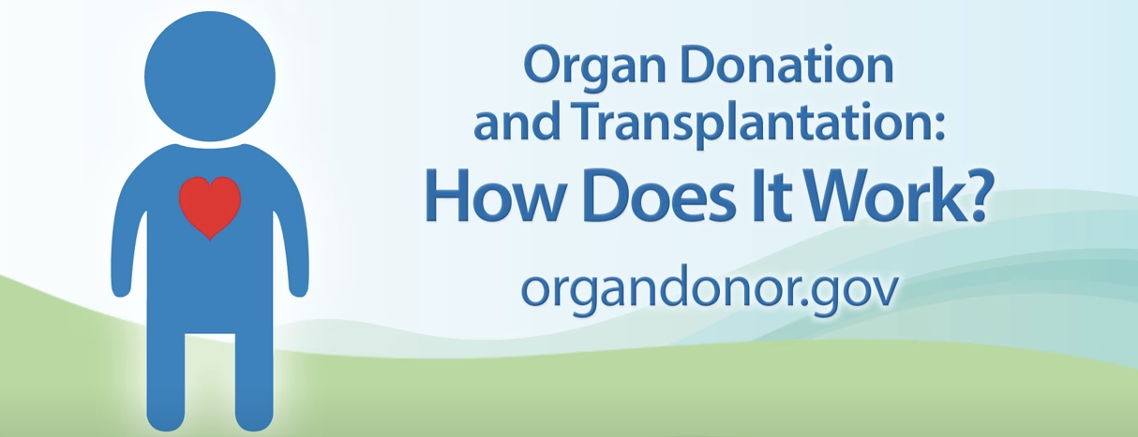
Can I Be a Part of the Organ Donation Process?
Click on the image to proceed to a short video.

Slide 29
Is it Important to Make a Decision?
Discuss donation with your family, even though many people don’t like to discuss end-of-life situations.
Decide what you want to do and share with your family. That way they do not have to wonder what you want.
Document your decision when applying for your driver’s license.
Notes:
There are animations on this slide - they will advance on click.

Slide 30
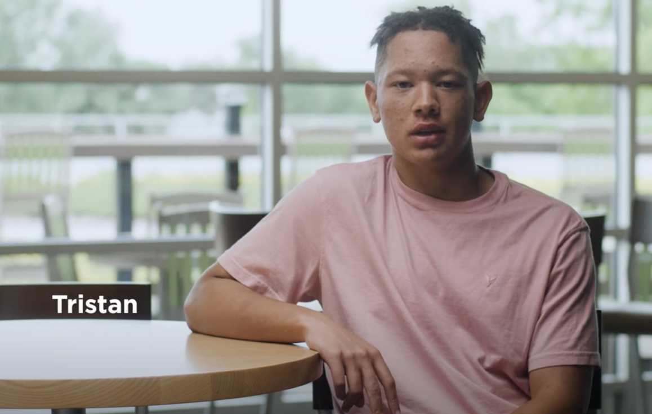
Click on the image to proceed to a short video.

Slide 31
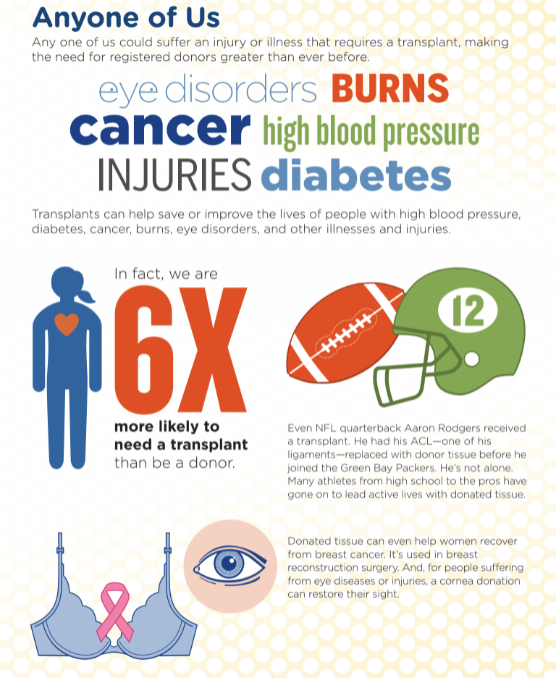
Notes:
You never know when one of us could be added to that list of over 100,000 people waiting for an organ transplant.
Resource: Donate Life Wisconsin

Slide 32
Are there more resources available?
Donate Life Wisconsin
  Donate Life Wisconsin/Resources
Wisconsin Department of Health Services: Organ & Tissue Donation Program FAQ
Donate Life America FAQ
United Network for Organ Sharing

Slide 33
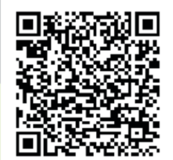
Can I Register to be a Donor?
Here are the ways to register for the Wisconsin Donor Registry:
Check when applying for your driver’s license at the DMV.
Sign up online at the Donate Life Wisconsin website.
Sign up when you apply for a hunting, fishing or trapping license with the DNR.

Slide 34
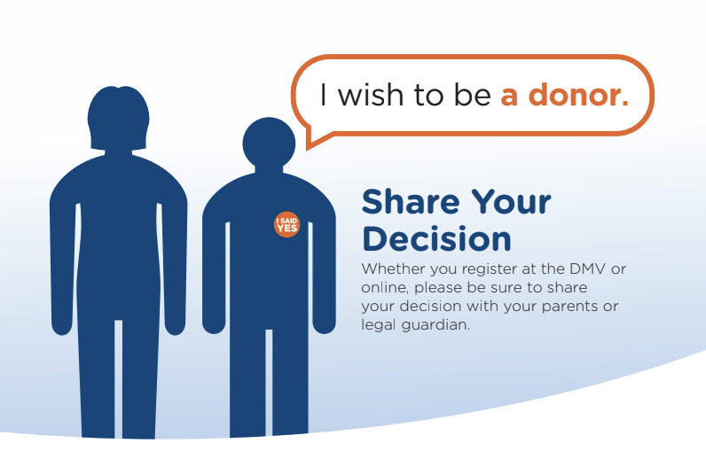

Slide 35

Thank you for participating in this presentation today. We hope you decide to experience the power of saying
https://donatelifewisconsin.org/

